Slide 1
Chapter 11 Inheritance and Polymorphism

Slide 2
Motivations
Suppose you will define classes to model circles, rectangles, and triangles. These classes have many common features. What is the best way to design these classes so to avoid redundancy? The answer is to use inheritance.
Object-oriented programming allows you to define new classes from existing classes.
This is called inheritance.

Slide 3
Objectives
    To define a subclass from a superclass through inheritance.
    To invoke the superclass’s constructors and methods using the super keyword.
    To override instance methods in the subclass.
    To distinguish differences between overriding and overloading.
    To explore the toString() method in the Object class.
    To discover polymorphism and dynamic binding .
    To describe casting and explain why explicit casting is necessary.
    To explore the equals method in the Object class.
    To store, retrieve, and manipulate objects in an ArrayList.
    To enable data and methods in a superclass accessible from subclasses using the protected visibility modifier.
    To prevent class extending and method overriding using the final modifier.

Slide 4
Superclasses and Subclasses
Inheritance enables you to define a general
class (i.e., a superclass) and later extend it to more specialized classes (i.e., subclasses).

Slide 5
Superclasses and Subclasses
Different classes may have some common
properties and behaviors, which can be
generalized in a class that can be shared by
other classes.
You can define a specialized class that extends
the generalized class.
The specialized classes inherit the properties
and methods from the general class.

Slide 6

Superclasses and Subclasses
A triangular arrow pointing to
the superclass is used to denote the inheritance relationship between the two classes involved
A subclass inherits accessible
data fields and methods from its superclass and may also add new data fields and methods.

Slide 7
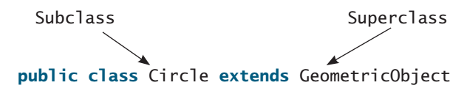
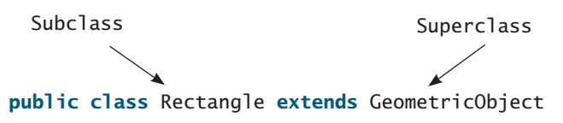
Superclasses and Subclasses
Syntax:
GeometricObject
CircleFromSimpleGeometricObject
TestCircleRectangle
RectangleFromSimpleGeometricObject
Run

Slide 8
Using the Keyword super
The keyword super refers to the superclass of the class in which super appears. This keyword can be used in two ways:
To call a superclass constructor
To call a superclass method

Slide 9
Calling Superclass Constructors
A constructor is used to construct an instance of a class.
Unlike properties and methods, a superclass's constructors are not inherited in the subclass.
They can only be invoked from the subclasses' constructors, using the keyword super.

Slide 10
Calling Superclass Constructors
The syntax to call a superclass’s constructor is:
super(), or super(parameters);
The statement super() invokes the no-arg
constructor of its superclass, and the statement
super(arguments) invokes the superclass
constructor that matches the arguments.

Slide 11
Calling Superclass Constructors
The statement super() or super(arguments) must be the first statement of the subclass’s constructor; this is the only way to explicitly invoke a superclass constructor.
Example:
public CircleFromSimpleGeometricObject(
double radius, String color, boolean filled) {
super(color, filled);
this.radius = radius;
}

Slide 12


Superclass’s Constructor Is Always Invoked
A constructor may invoke an overloaded constructor or its superclass’s constructor. If none of them is invoked explicitly, the compiler puts super() as the first statement in the constructor. For example,

Slide 13
CAUTION
You must use the keyword super to call the superclass constructor.
Invoking a superclass constructor’s name in a subclass causes a syntax error.
Java requires that the statement that uses the keyword super appear first in the constructor.

Slide 14
Constructor Chaining
Constructing an instance of a class invokes all the superclasses’ constructors along the inheritance chain. This is known as constructor chaining.

Slide 15
Constructor Chaining
Constructing an instance of a class invokes all the superclasses’ constructors along the inheritance chain. This is known as constructor chaining.
public class Faculty extends Employee {
public static void main(String[] args) {
new Faculty();
}
public Faculty() {
System.out.println("(4) Faculty's no-arg constructor is invoked");
}
}
class Employee extends Person {
public Employee() {
this("(2) Invoke Employee’s overloaded constructor");
System.out.println("(3) Employee's no-arg constructor is invoked");
}
public Employee(String s) {
System.out.println(s);
}
}
class Person {
public Person() {
System.out.println("(1) Person's no-arg constructor is invoked");
}
}

Slide 16
Trace Execution
animation
public class Faculty extends Employee {
public static void main(String[] args) {
new Faculty();
}
public Faculty() {
System.out.println("(4) Faculty's no-arg constructor is invoked");
}
}
class Employee extends Person {
public Employee() {
this("(2) Invoke Employee’s overloaded constructor");
System.out.println("(3) Employee's no-arg constructor is invoked");
}
public Employee(String s) {
System.out.println(s);
}
}
class Person {
public Person() {
System.out.println("(1) Person's no-arg constructor is invoked");
}
}
1. Start from the main method

Slide 17
Trace Execution
animation
public class Faculty extends Employee {
public static void main(String[] args) {
new Faculty();
}
public Faculty() {
System.out.println("(4) Faculty's no-arg constructor is invoked");
}
}
class Employee extends Person {
public Employee() {
this("(2) Invoke Employee’s overloaded constructor");
System.out.println("(3) Employee's no-arg constructor is invoked");
}
public Employee(String s) {
System.out.println(s);
}
}
class Person {
public Person() {
System.out.println("(1) Person's no-arg constructor is invoked");
}
}
2. Invoke Faculty constructor

Slide 18
Trace Execution
animation
public class Faculty extends Employee {
public static void main(String[] args) {
new Faculty();
}
public Faculty() {
System.out.println("(4) Faculty's no-arg constructor is invoked");
}
}
class Employee extends Person {
public Employee() {
this("(2) Invoke Employee’s overloaded constructor");
System.out.println("(3) Employee's no-arg constructor is invoked");
}
public Employee(String s) {
System.out.println(s);
}
}
class Person {
public Person() {
System.out.println("(1) Person's no-arg constructor is invoked");
}
}
3. Invoke Employee’s no-arg constructor

Slide 19
Trace Execution
animation
public class Faculty extends Employee {
public static void main(String[] args) {
new Faculty();
}
public Faculty() {
System.out.println("(4) Faculty's no-arg constructor is invoked");
}
}
class Employee extends Person {
public Employee() {
this("(2) Invoke Employee’s overloaded constructor");
System.out.println("(3) Employee's no-arg constructor is invoked");
}
public Employee(String s) {
System.out.println(s);
}
}
class Person {
public Person() {
System.out.println("(1) Person's no-arg constructor is invoked");
}
}
4. Invoke Employee(String) constructor

Slide 20
Trace Execution
animation
public class Faculty extends Employee {
public static void main(String[] args) {
new Faculty();
}
public Faculty() {
System.out.println("(4) Faculty's no-arg constructor is invoked");
}
}
class Employee extends Person {
public Employee() {
this("(2) Invoke Employee’s overloaded constructor");
System.out.println("(3) Employee's no-arg constructor is invoked");
}
public Employee(String s) {
System.out.println(s);
}
}
class Person {
public Person() {
System.out.println("(1) Person's no-arg constructor is invoked");
}
}
5. Invoke Person() constructor

Slide 21
Trace Execution
animation
public class Faculty extends Employee {
public static void main(String[] args) {
new Faculty();
}
public Faculty() {
System.out.println("(4) Faculty's no-arg constructor is invoked");
}
}
class Employee extends Person {
public Employee() {
this("(2) Invoke Employee’s overloaded constructor");
System.out.println("(3) Employee's no-arg constructor is invoked");
}
public Employee(String s) {
System.out.println(s);
}
}
class Person {
public Person() {
System.out.println("(1) Person's no-arg constructor is invoked");
}
}
6. Execute println

Slide 22
Trace Execution
animation
public class Faculty extends Employee {
public static void main(String[] args) {
new Faculty();
}
public Faculty() {
System.out.println("(4) Faculty's no-arg constructor is invoked");
}
}
class Employee extends Person {
public Employee() {
this("(2) Invoke Employee’s overloaded constructor");
System.out.println("(3) Employee's no-arg constructor is invoked");
}
public Employee(String s) {
System.out.println(s);
}
}
class Person {
public Person() {
System.out.println("(1) Person's no-arg constructor is invoked");
}
}
7. Execute println

Slide 23
Trace Execution
animation
public class Faculty extends Employee {
public static void main(String[] args) {
new Faculty();
}
public Faculty() {
System.out.println("(4) Faculty's no-arg constructor is invoked");
}
}
class Employee extends Person {
public Employee() {
this("(2) Invoke Employee’s overloaded constructor");
System.out.println("(3) Employee's no-arg constructor is invoked");
}
public Employee(String s) {
System.out.println(s);
}
}
class Person {
public Person() {
System.out.println("(1) Person's no-arg constructor is invoked");
}
}
8. Execute println

Slide 24
Trace Execution
animation
public class Faculty extends Employee {
public static void main(String[] args) {
new Faculty();
}
public Faculty() {
System.out.println("(4) Faculty's no-arg constructor is invoked");
}
}
class Employee extends Person {
public Employee() {
this("(2) Invoke Employee’s overloaded constructor");
System.out.println("(3) Employee's no-arg constructor is invoked");
}
public Employee(String s) {
System.out.println(s);
}
}
class Person {
public Person() {
System.out.println("(1) Person's no-arg constructor is invoked");
}
}
9. Execute println

Slide 25
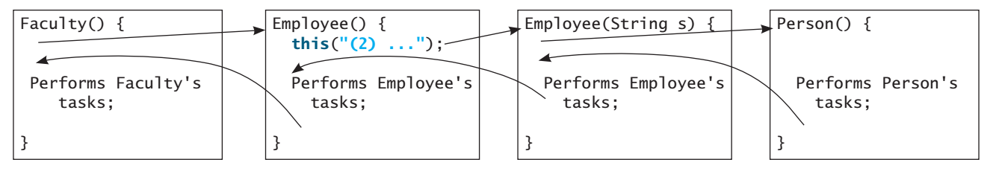
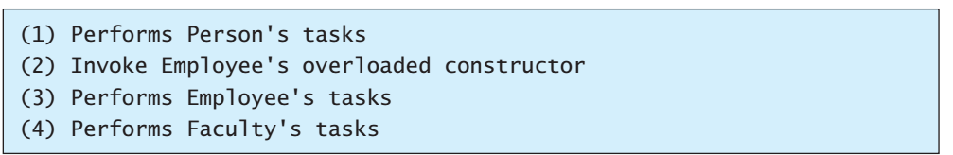
Constructor Chaining (cont.)
Output:

Slide 26
Example on the Impact of a Superclass without no-arg Constructor
Find out the errors in the program:
public class Apple extends Fruit {
}
class Fruit {
public Fruit(String name) {
System.out.println("Fruit's constructor is invoked");
}
}
Since no constructor is explicitly defined in Apple, Apple’s default no-arg
constructor is defined implicitly. Since Apple is a subclass of Fruit, Apple’s
default constructor automatically invokes Fruit’s no-arg constructor. However,
Fruit does not have a no-arg constructor, because Fruit has an explicit constructor
defined. Therefore, the program cannot be compiled.

Slide 27
Defining a Subclass
A subclass inherits from a superclass. You can also:
  Add new properties
  Add new methods
  Override the methods of the superclass

Slide 28
Calling Superclass Methods
The keyword super can also be used to reference a method other than the constructor in the superclass. The syntax is:
super.method(parameters);
You could rewrite the printCircle() method in the Circle class as follows:
public void printCircle() {
System.out.println("The circle is created " +
super.getDateCreated() + " and the radius is " + radius);
}

Slide 29
Overriding Methods in the Superclass
A subclass inherits methods from a superclass.
Sometimes it is necessary for the subclass to modify the implementation of a method defined in the superclass.
This is referred to as method overriding.
To override a method, the method must be defined in the subclass using the same signature and the same return type as in its superclass.

Slide 30
Overriding Methods in the Superclass
public class Circle extends GeometricObject {
// Other methods are omitted
/** Override the toString method defined in GeometricObject */
public String toString() {
return super.toString() + "\nradius is " + radius;
}
}

Slide 31
Overriding vs. Overloading
Overloading means to define multiple
methods with the same name but different
signatures.
Overriding means to provide a new
implementation for a method in the
subclass.

Slide 32

Overriding vs. Overloading

Slide 33
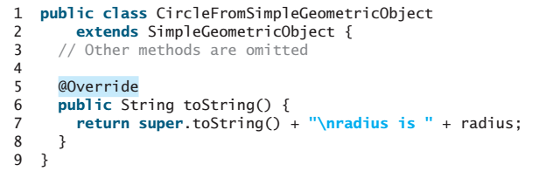
Overriding
To avoid mistakes, you can use a special Java syntax, called override annotation, to place @Override before the method in the subclass. For example:
If a method with this annotation does not override its superclass’s method, the compiler will report an error.

Slide 34
NOTE
An instance method can be overridden only if it is accessible.
Thus a private method cannot be overridden, because it is not accessible outside its own class.
If a method defined in a subclass is private in its superclass, the two methods are completely unrelated.

Slide 35
NOTE
Like an instance method, a static method can be inherited.
However, a static method cannot be overridden.
If a static method defined in the superclass is redefined in a subclass, the method defined in the superclass is hidden.

Slide 36

The Object Class and Its Methods
Every class in Java is descended from the java.lang.Object class. If no inheritance is specified when a class is defined, the superclass of the class is Object.

Slide 37
The toString() method in Object
The toString() method returns a string representation of the object. The default implementation returns a string consisting of a class name of which the object is an instance, the at sign (@), the object’s memory address in hexadecimal.
Loan loan = new Loan();
System.out.println(loan.toString());
The code displays something like Loan@15037e5. This message is not very helpful or informative. Usually you should override the toString method so that it returns a digestible string representation of the object.

Slide 38
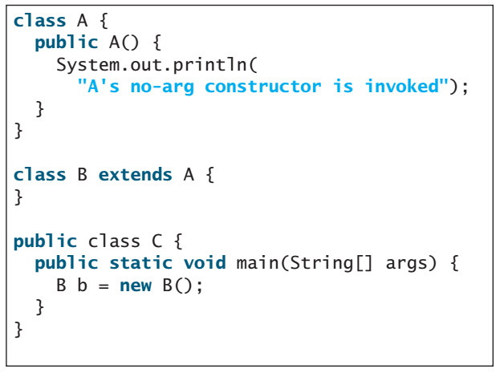

Exercise #1

Slide 39
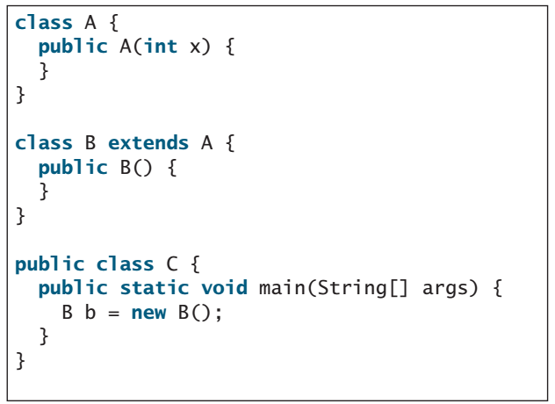
Exercise #2: What problem arises in compiling the following program?
Compile error: The default constructor of B attempts to invoke the
default of constructor of A, but class A's default constructor is not defined.

Slide 40
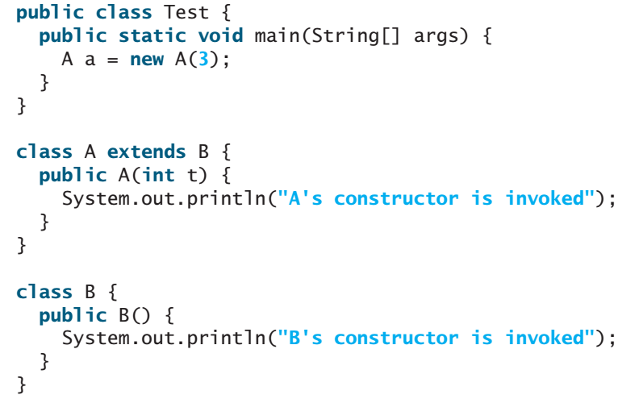
Exercise #3
Output: B’s constructor is invoked
A’s constructor is invoked

Slide 41
Polymorphism
Polymorphism means that a variable of a supertype can refer to a subtype object.

Slide 42
Polymorphism
A class defines a type.
A type defined by a subclass is called a subtype, and a type defined by its superclass is called a supertype.
Therefore, you can say that Circle is a subtype of GeometricObject and GeometricObject is a supertype for Circle.

Slide 43
Polymorphism
Every instance of a subclass is also an instance of its superclass, but not vice versa.
For example, every circle is a geometric
object, but not every geometric object is a circle.
Therefore, you can always pass an instance
of a subclass to a parameter of its superclass type
PolymorphismDemo
Run

Slide 44
Dynamic Binding
Same method can be implemented in several classes in the class relationship hierarchy. JVM decides which method to invoke at runtime.
Object o = new GeometricObject();
System.out.println(o.toString());
Declared Type: Type that declares a variable
Actual Type: Type that is assigned based on the Class whose constructor is used
JVM searches for the implementation of the method starting from lowest child method in the hierarchy till it finds an implementation.

Slide 45

Dynamic Binding
Dynamic binding works as follows:
Suppose an object o is an instance of classes C₁, C₂, ..., C_{n-1}, and C_{n}, where C₁ is a subclass of C₂, C₂ is a subclass of C₃, ..., and C_{n-1} is a subclass of C_{n}.
That is, C_{n} is the most general class, and C₁ is the most specific class. In Java, C_{n} is the Object class.

Slide 46
Dynamic Binding
If o invokes a method p, the JVM searches the implementation for the method p in C₁, C₂, ..., C_{n-1} and C_{n}, in this order, until it is found.
Once an implementation is found, the search stops and the first-found implementation is invoked.

Slide 47
Polymorphism and Dynamic Binding
public class PolymorphismDemo {
public static void main(String[] args) {
m(new GraduateStudent());
m(new Student());
m(new Person());
m(new Object());
}
public static void m(Object x) {
System.out.println(x.toString());
}
}
class GraduateStudent extends Student {
}
class Student extends Person {
public String toString() {
return "Student";
}
}
class Person extends Object {
public String toString() {
return "Person";
}
}
Method m takes a parameter of the Object type. You can invoke it with any object.
An object of a subtype can be used wherever its supertype value is required. This feature is known as polymorphism.
When the method m(Object x) is executed, the argument x’s toString method is invoked. x may be an instance of GraduateStudent, Student, Person, or Object.
Classes GraduateStudent, Student, Person, and Object have their own implementation of the toString method.
Which implementation is used will be determined dynamically by the Java Virtual Machine (JVM) at runtime. This capability is known as dynamic binding.
DynamicBindingDemo
Run

Slide 48
Method Matching vs. Binding
Matching a method signature and binding a method implementation are two issues.
The compiler finds a matching method according to parameter type, number of parameters, and order of the parameters at compilation time.
A method may be implemented in several subclasses. The Java Virtual Machine dynamically binds the implementation of the method at runtime.

Slide 49
Generic Programming
public class PolymorphismDemo {
public static void main(String[] args) {
m(new GraduateStudent());
m(new Student());
m(new Person());
m(new Object());
}
public static void m(Object x) {
System.out.println(x.toString());
}
}
class GraduateStudent extends Student {
}
class Student extends Person {
public String toString() {
return "Student";
}
}
class Person extends Object {
public String toString() {
return "Person";
}
}
Generic programming: Polymorphism allows methods to be used generically for a wide range of object arguments.
If a method’s parameter type is a superclass (e.g., Object), you may pass an object to this method of any of the parameter’s subclasses (e.g., Student or String).
When an object (e.g., a Student object or a String object) is used in the method, the particular implementation of the method of the object that is invoked (e.g., toString) is determined dynamically.

Slide 50
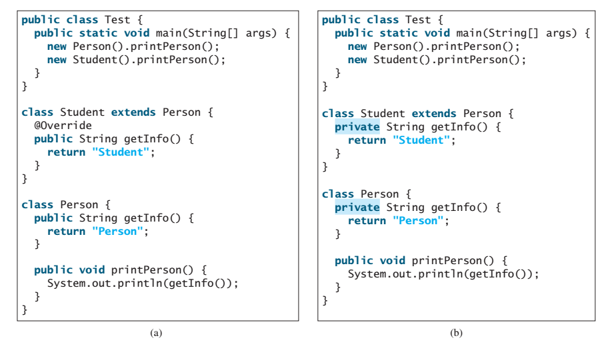
Exercise #4: Show the output of the following code
Person
Student
Person
Person

Slide 51
Casting Objects
You have already used the casting operator to convert variables of one primitive type to another. Casting can also be used to convert an object of one class type to another within an inheritance hierarchy. In the preceding section, the statement
  m(new Student());
assigns the object new Student() to a parameter of the Object type. This statement is equivalent to:
  Object o = new Student(); // Implicit casting
  m(o);
The statement Object o = new Student(), known as implicit casting, is legal because an instance of Student is automatically an instance of Object.

Slide 52
Why Casting Is Necessary?
Suppose you want to assign the object reference o to a variable of the Student type using the following statement:
  Student b = o;
A compile error would occur.
Why does the statement Object o = new Student() work and the statement
Student b = o doesn’t?
This is because a Student object is always an instance of Object, but an Object is not necessarily an instance of Student.
Even though you can see that o is really a Student object, the compiler is not so clever to know it.
  Student b = (Student)o; // Explicit casting

Slide 53
Why Casting Is Necessary?
To tell the compiler that o is a Student object, use an explicit casting.
The syntax is similar to the one used for casting among primitive data types. Enclose the target object type in parentheses and place it before the object to be cast, as follows:
  Student b = (Student)o; // Explicit casting

Slide 54
Upcasting
It is always possible to cast an instance of a subclass to a variable of a superclass (known as upcasting), because an instance of a subclass is always an instance of its superclass.

Slide 55
Downcasting
When casting an instance of a superclass to a variable of its subclass (known as downcasting), explicit casting must be used to confirm your intention to the compiler with the (SubclassName) cast notation.

Slide 56
Casting
For the casting to be successful, you must
make sure that the object to be cast is an
instance of the subclass.
If the superclass object is not an instance of
the subclass, a runtime ClassCastException
occurs.
For example, if an object is not an instance
of Student, it cannot be cast into a variable
of Student.

Slide 57
The instanceof Operator
Use the instanceof operator to test whether an object is an instance of a class:
  Object myObject = new Circle();
  ... // Some lines of code
  /** Perform casting if myObject is an instance of Circle */
  if (myObject instanceof Circle) {
  System.out.println("The circle diameter is " +
  ((Circle)myObject).getDiameter());
  ...
  }

Slide 58
Caution!
The object member access operator (.) precedes the casting operator. Hence parentheses is used to ensure casting before compiler uses the . Operator
((Circle)object).getArea();

Slide 59
TIP
To help understand casting, you may also consider the analogy of fruit, apple, and orange with the Fruit class as the superclass for Apple and Orange. An apple is a fruit, so you can always safely assign an instance of Apple to a variable for Fruit. However, a fruit is not necessarily an apple, so you have to use explicit casting to assign an instance of Fruit to a variable of Apple.

Slide 60
Exercise #5:What is wrong in the following code?
public class Test {
public static void main(String[] args) {
Object fruit = new Fruit();
Object apple = (Apple)fruit;
}
}
class Apple extends Fruit {
}
class Fruit {
}
Causes a runtime ClassCastingException

Slide 61
Example: Demonstrating Polymorphism and Casting
This example creates two geometric objects: a circle, and a rectangle, invokes the displayGeometricObject method to display the objects. The displayGeometricObject displays the area and diameter if the object is a circle, and displays area if the object is a rectangle.
CastingDemo
Run

Slide 62
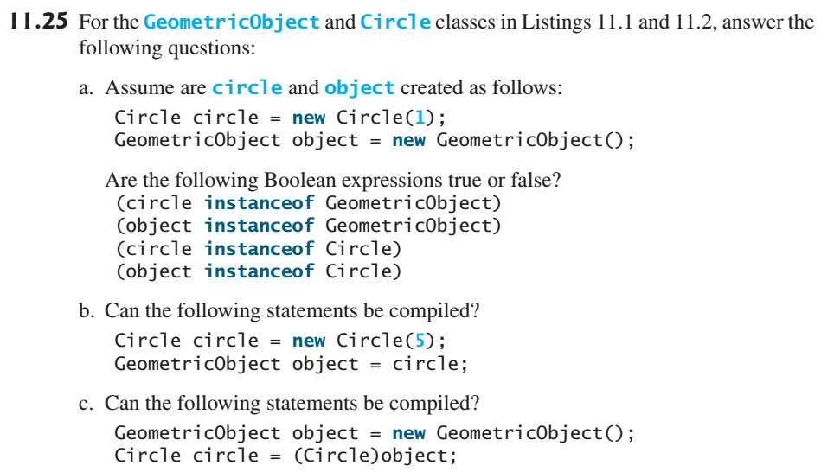
Exercise #6:
Trne
True
True
False
Yes, because you can always cast from subclass to superclass.
Runtime exception (ClassCastException)

Slide 63
The equals Method
The equals() method compares the contents of two objects. The default implementation of the equals method in the Object class is as follows:
public boolean equals(Object obj) {
return this == obj;
}
For example, the equals method is overridden in the Circle class.
public boolean equals(Object o) {
if (o instanceof Circle) {
return radius == ((Circle)o).radius;
}
else
return false;
}

Slide 64
NOTE
The == comparison operator is used for comparing two primitive data type values or for determining whether two objects have the same references.
The equals method is intended to test whether two objects have the same contents, provided that the method is modified in the defining class of the objects.
The == operator is stronger than the equals method, in that the == operator checks whether the two reference variables refer to the same object.

Slide 65
== for String
String obj1 = new String("xyz");
String obj2 = new String("xyz");
if(obj1 == obj2) → false
String obj1 = new String("xyz");
String obj2 = obj1;
if(obj1 == obj2) → true

Slide 66
equals for String
String class overrides the method so that it checks only the values of the strings, not their locations in memory.
String obj1 = new String("xyz");
String obj2 = new String("xyz");
if(obj1.equals(obj2)) → true

Slide 67
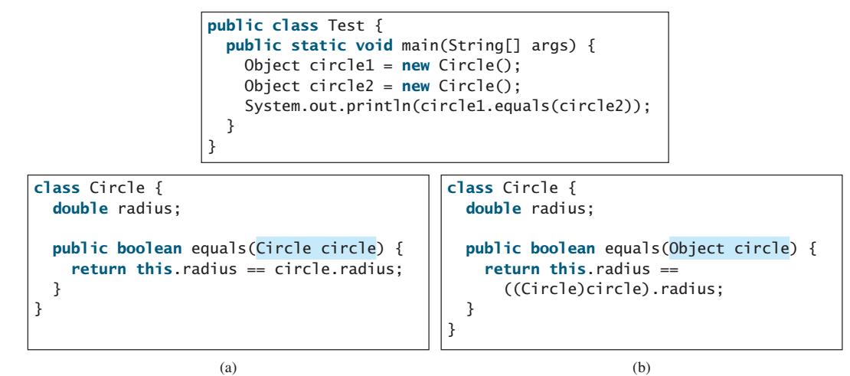
Exercise #7:
Show the output of running class Test with the Circle class in (a) and in (b), respectively.
False
True

Slide 68
The ArrayList Class
An ArrayList object can be used to store a list of objects.
You can create an array to store objects. But, once the array is created, its size is fixed.
Java provides the ArrayList class, which can be used to store an unlimited number of objects.

Slide 69
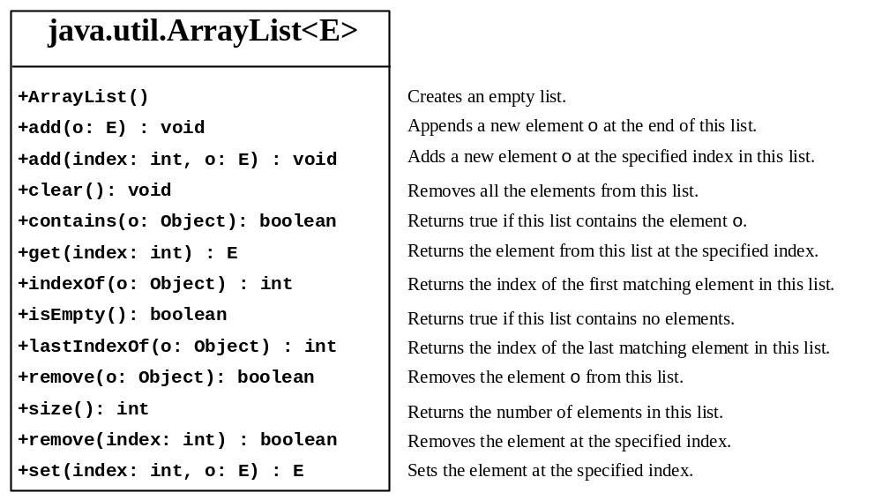
The ArrayList Class

Slide 70
Generic Type
ArrayList is known as a generic class with a generic type E.
You can specify a concrete type to replace E when creating an ArrayList.
For example, the following statement creates an ArrayList and assigns its reference to variable cities. This ArrayList object can be used to store strings.
ArrayList<String> cities = new ArrayList<String>();
ArrayList<String> cities = new ArrayList<>();
TestArrayList
Run

Slide 71
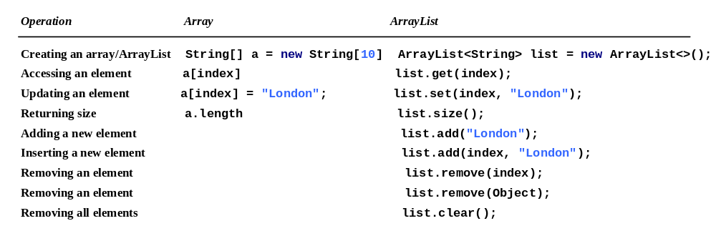
Differences and Similarities between Arrays and ArrayList

Slide 72

The protected Modifier
The protected modifier can be applied on data and methods in a class. A protected data or a protected method in a public class can be accessed by any class in the same package or its subclasses, even if the subclasses are in a different package.
private, default, protected, public

Slide 73

Accessibility Summary

Slide 74

Visibility Modifiers

Slide 75
A Subclass Cannot Weaken the Accessibility
A subclass may override a protected method in its superclass and change its visibility to public.
However, a subclass cannot weaken the accessibility of a method defined in the superclass.
For example, if a method is defined as public in the superclass, it must be defined as public in the subclass.

Slide 76
The final Modifier
The final class cannot be extended:
final class Math {
...
}
The final variable is a constant:
final static double PI = 3.14159;
The final method cannot be overridden by its subclasses.

Slide 77
Note
The modifiers are used on classes and
class members (data and methods), except
that the final modifier can also be used on
local variables in a method. A final local
variable is a constant inside a method.

Slide 78
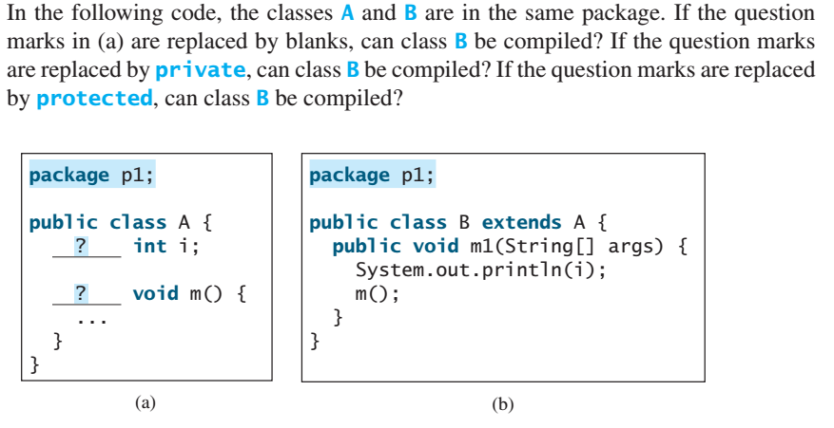
Exercise #8:
Blank → Yes
Private → No
Protected → Yes

Slide 79
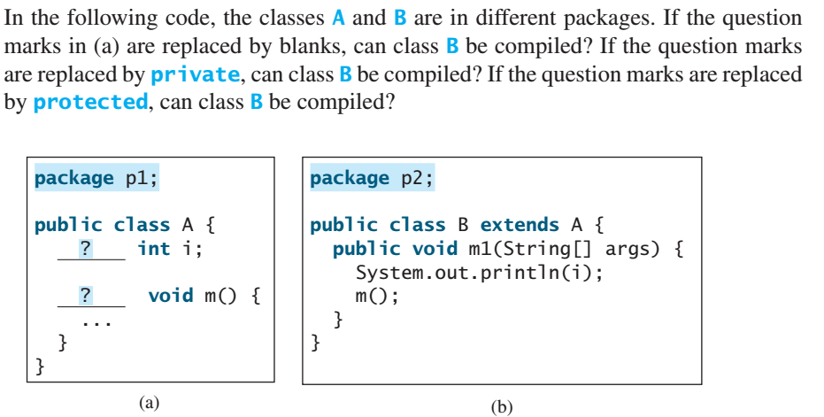
Exercise #9:
Blank → No
Private → No
Protected → Yes

